Slide 1
New Automation Technology Beckhoff Automation

Slide 2
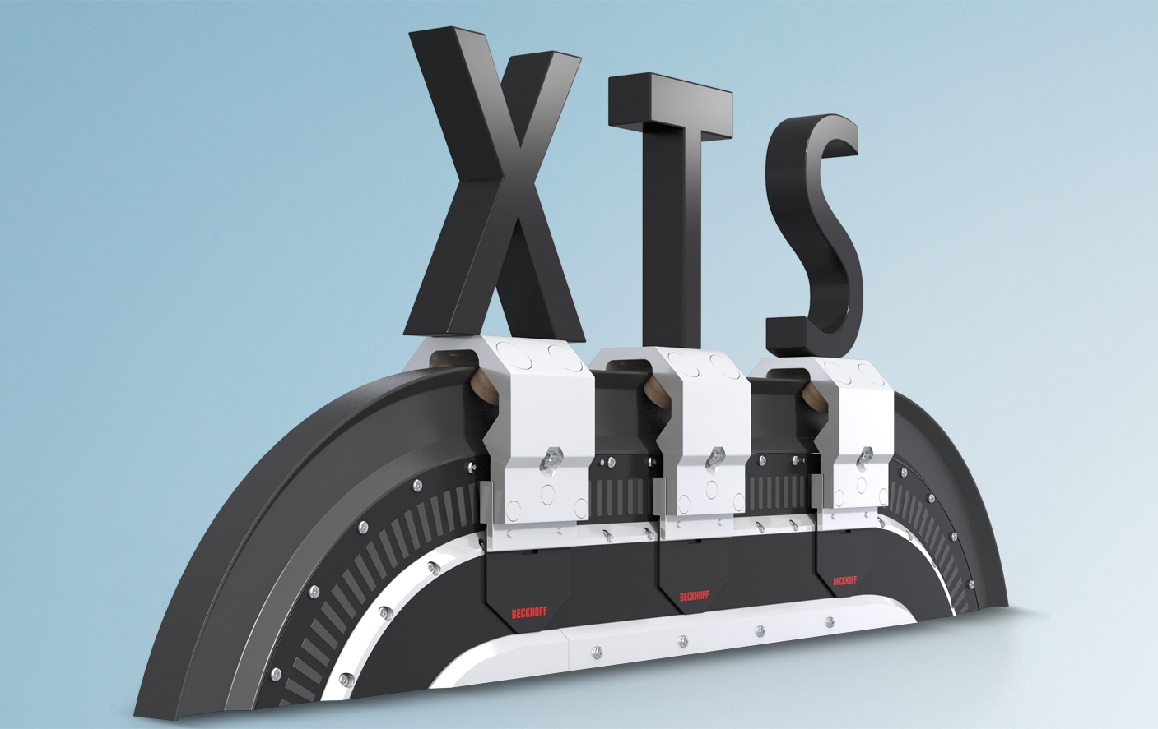
XTS Training

Slide 3
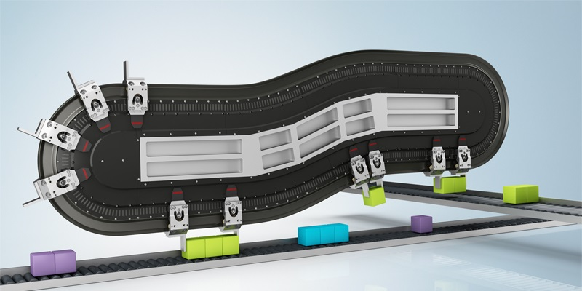
Agenda | XTS- Assembly
XTS-StarterKit
Preparation and Assembly
First Test
Rail mounting
Rerailing of Mover

Slide 4
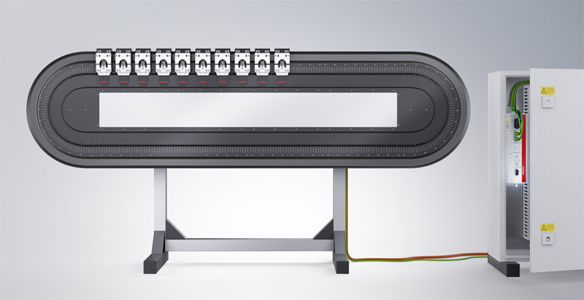
XTS StarterKit

Slide 5
XTS StarterKit
AT2000-0500 starter kit small, 500 mm straight length
AT2000-1000 starter kit medium, 1000 mm straight length
AT2000-1500 starter kit large, 1500 mm straight length

Slide 6
Agenda | XTS- Assembly
XTS-StarterKit
Preparation and Assembly
First Test
Rail mounting
Rerailing of Mover

Slide 7
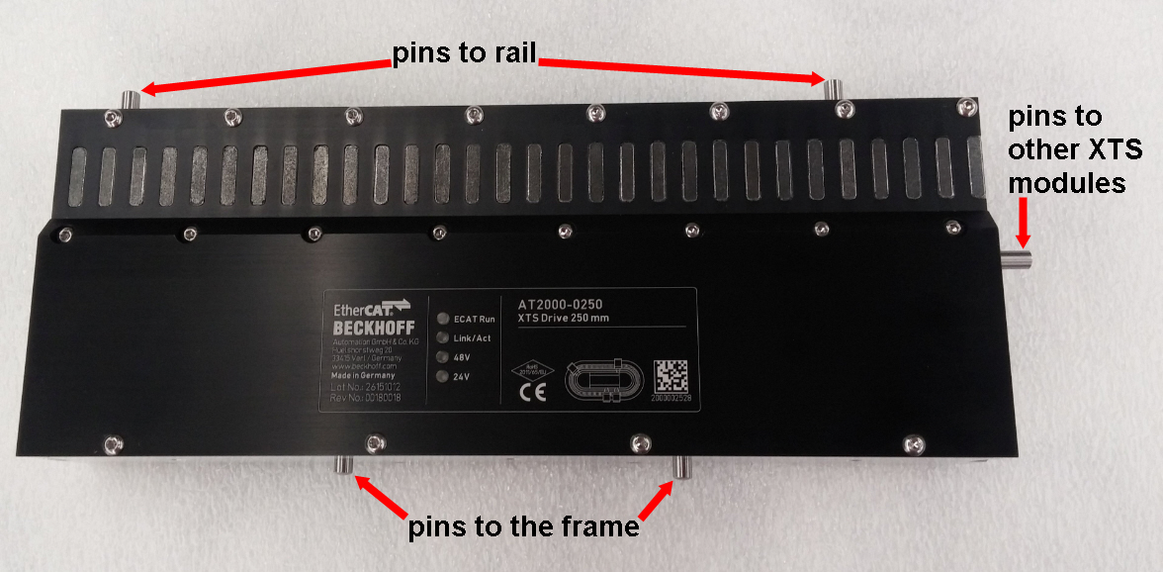
Prepare the XTS Modules
Insert all pins on the bottom side of the frame
Insert the pins to the rail
Insert the pins to the neighbor modules
4x D5x10 A2 DIN 7
1x D5x30 A2 DIN 7

Slide 8
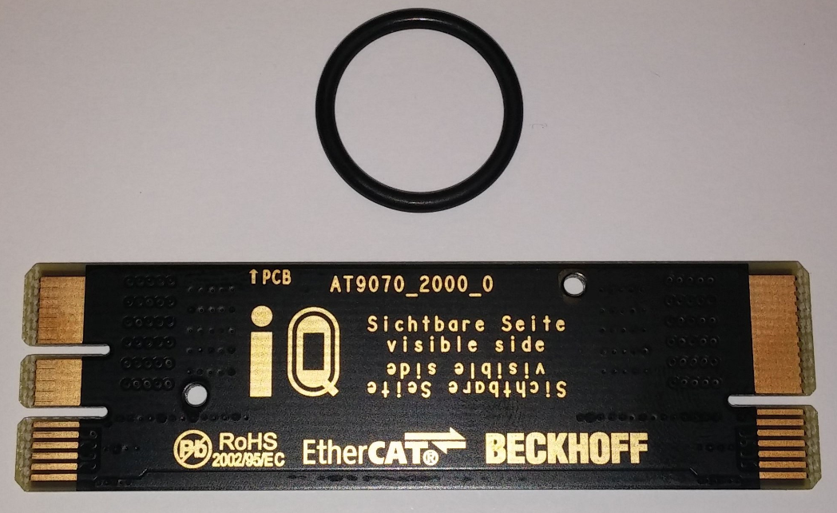
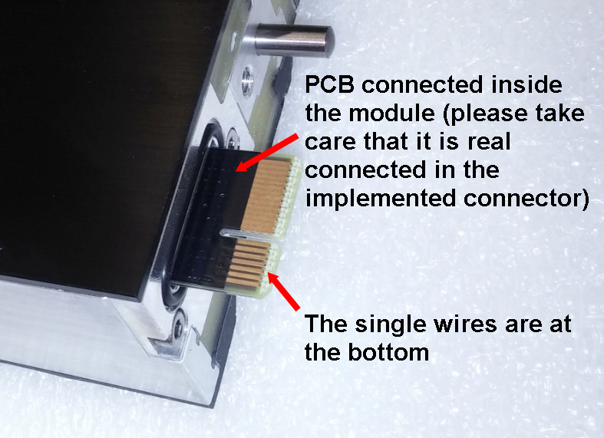
Prepare the XTS Modules
Insert O-ring (as sealing) on
the side of the module
Insert the connection PCB
Notes:
AWB – Text in pictures:
Left photo:
“The printed nameplate of the motor module and PCB face the same direction for proper assembly”
Right photo:
“Carefully insert the PCB into the internal connector of the motor module. Note the position of the connector with smaller pin package at the bottom.”

Slide 9
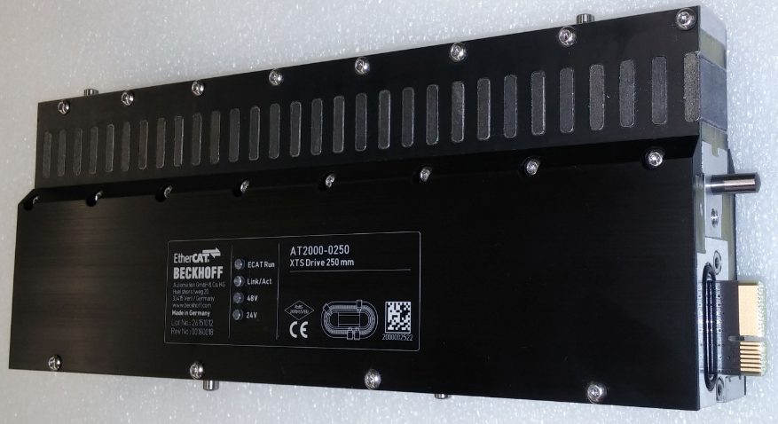
Prepare the XTS Modules

Slide 10
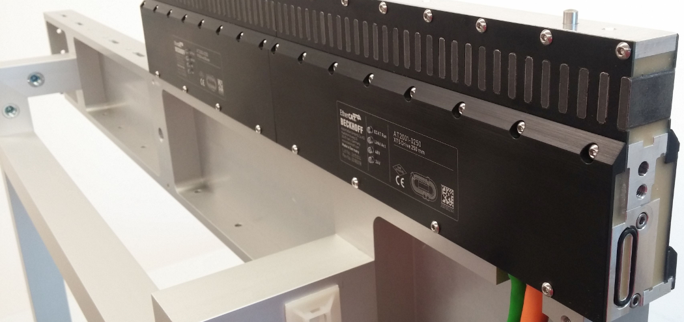
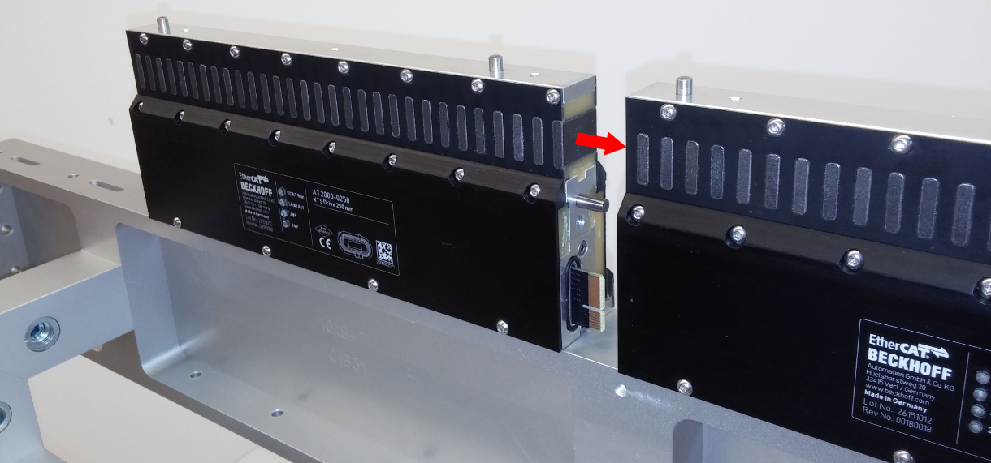
Module frame mounting
Beginning with the straight infeed module
Following with all other straights from both sides of the frame
The electrical connection is done by sliding the connection PCB in the neighbouring module

Slide 11
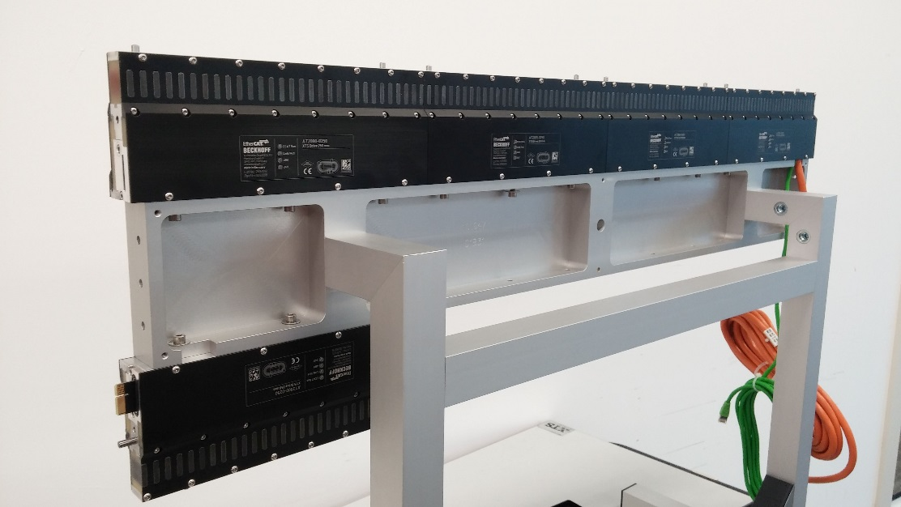
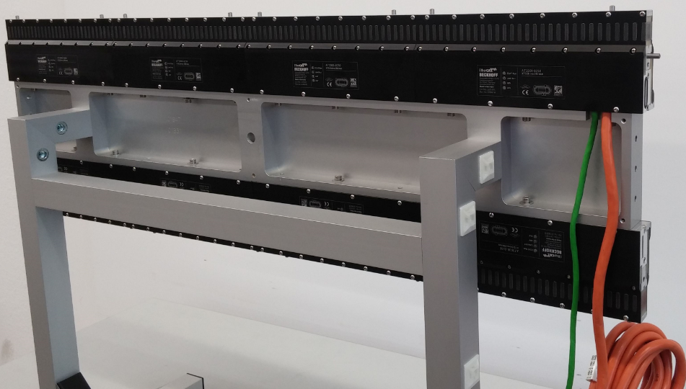
Module frame mounting
Fix the modules with
Screw M5x20 Cyl. A2 DIN 912
Washer M5 A2 DIN 9021
!
Do not tighten the screws to allow for adjustment of the modules

Slide 12
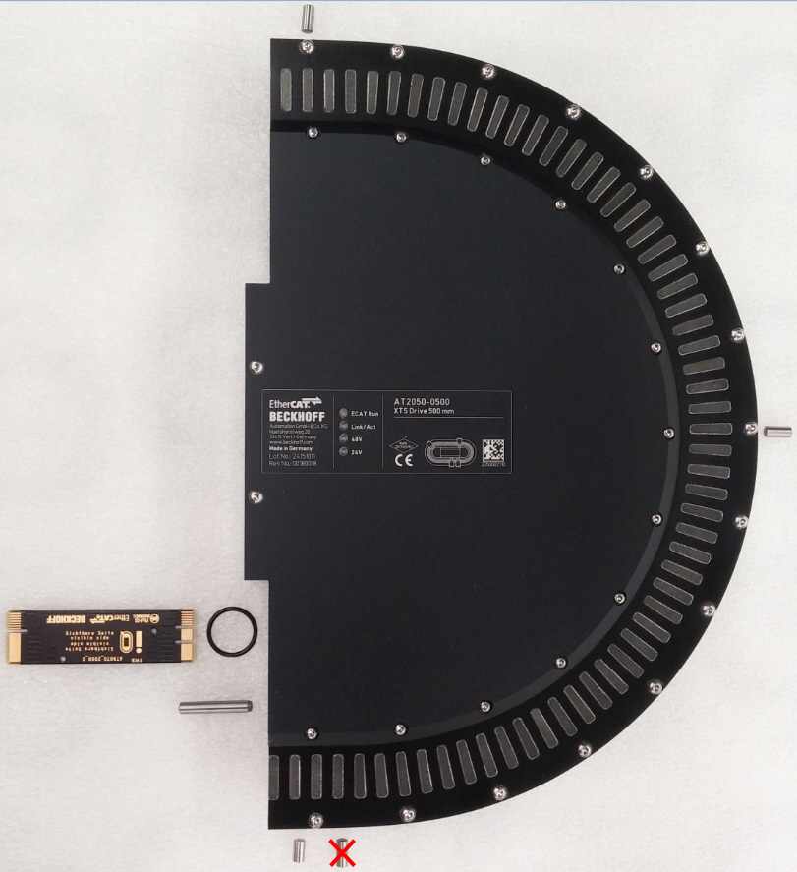
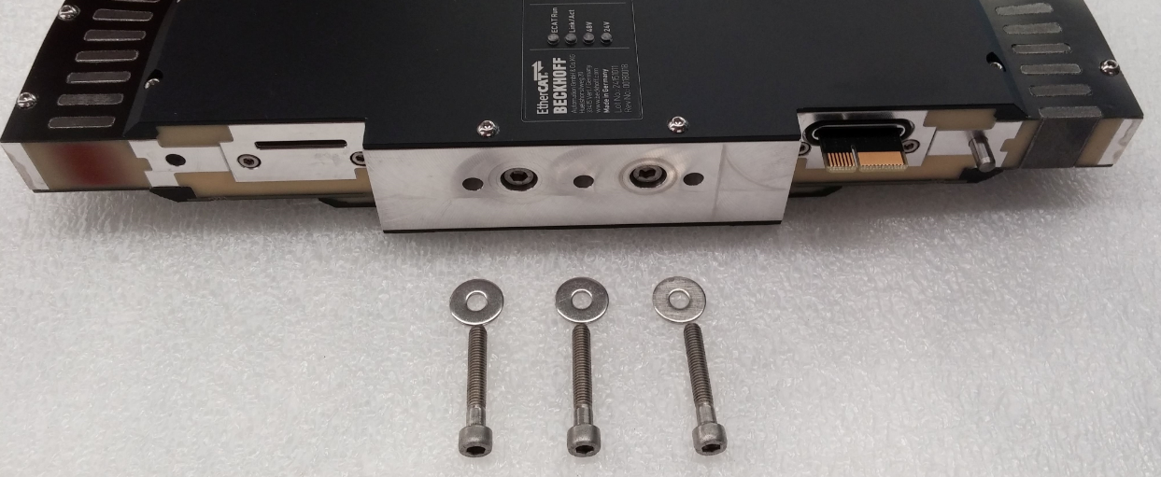
Prepare the XTS Modules
Mount the curve modules last
The curves will meet the straights as you tighten the screws to the frame
1 x Pin D5x30 A2 DIN 7
3 (2)x Pin D5x10 A2 DIN 7
(1) x Pin D5x8 A2 DIN 7 → lower HW28
1 x O-ring (as sealing)
1 x Connection PCB
Screw M5x30 Cyl. A2 DIN 912 &
Washer M5 A2 DIN 9021

Slide 13
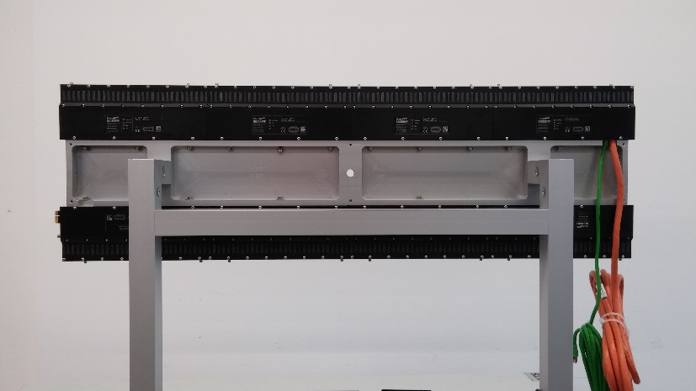
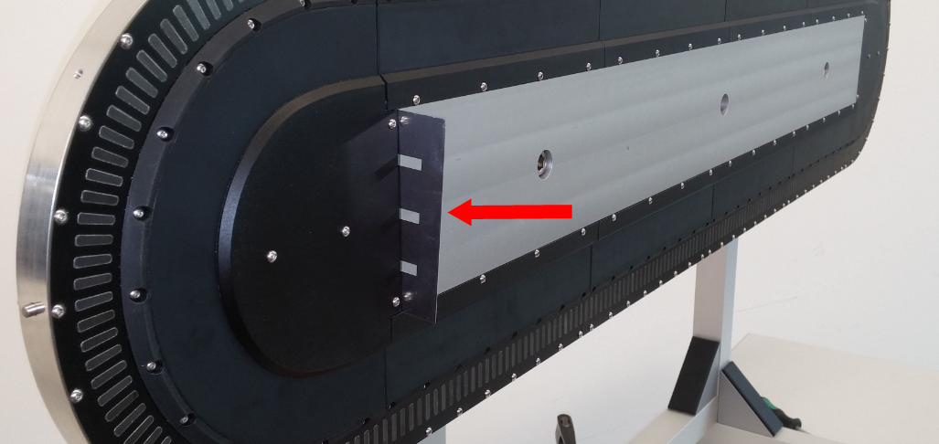
Module frame mounting
insert 1mm aluminum sheet at one side
Only before HW..
HW03 at 0.5m HW02 at 1.0m
HW02 at 1.5m

Slide 14
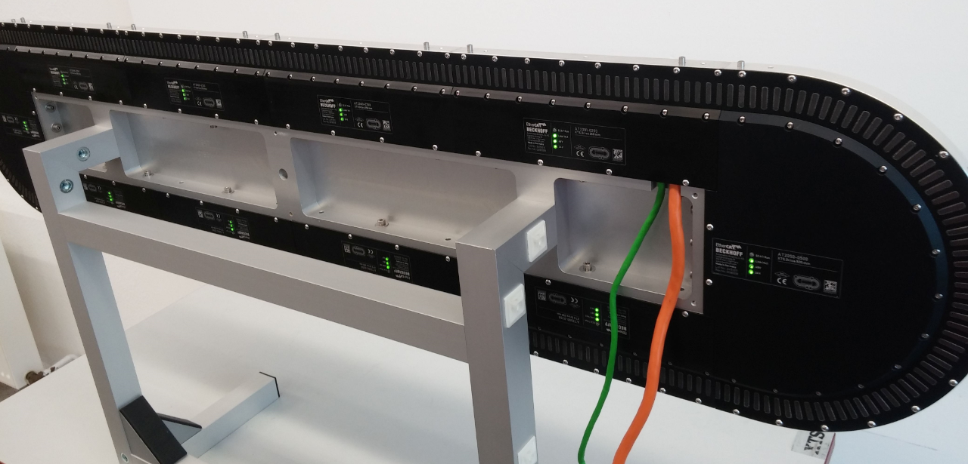
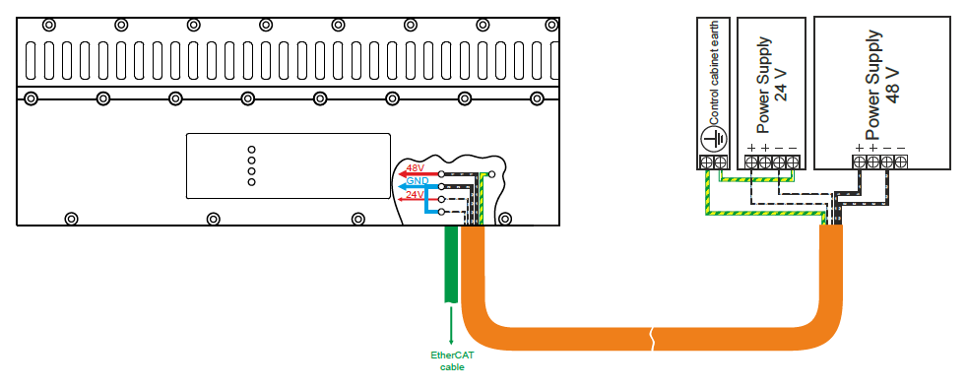
Module frame mounting
Pin out of the infeed module as labelled on the name plate and cable
Connect EtherCAT to the IPC or CU2508
PIN | Signal
1 | 48V
2 | GND 48V
3 | 24V
4 | GND 24V

Slide 15
Agenda | XTS- Assembly
XTS-StarterKit
Preparation and Assembly
First Test
Rail mounting
Rerailing of Mover

Slide 16
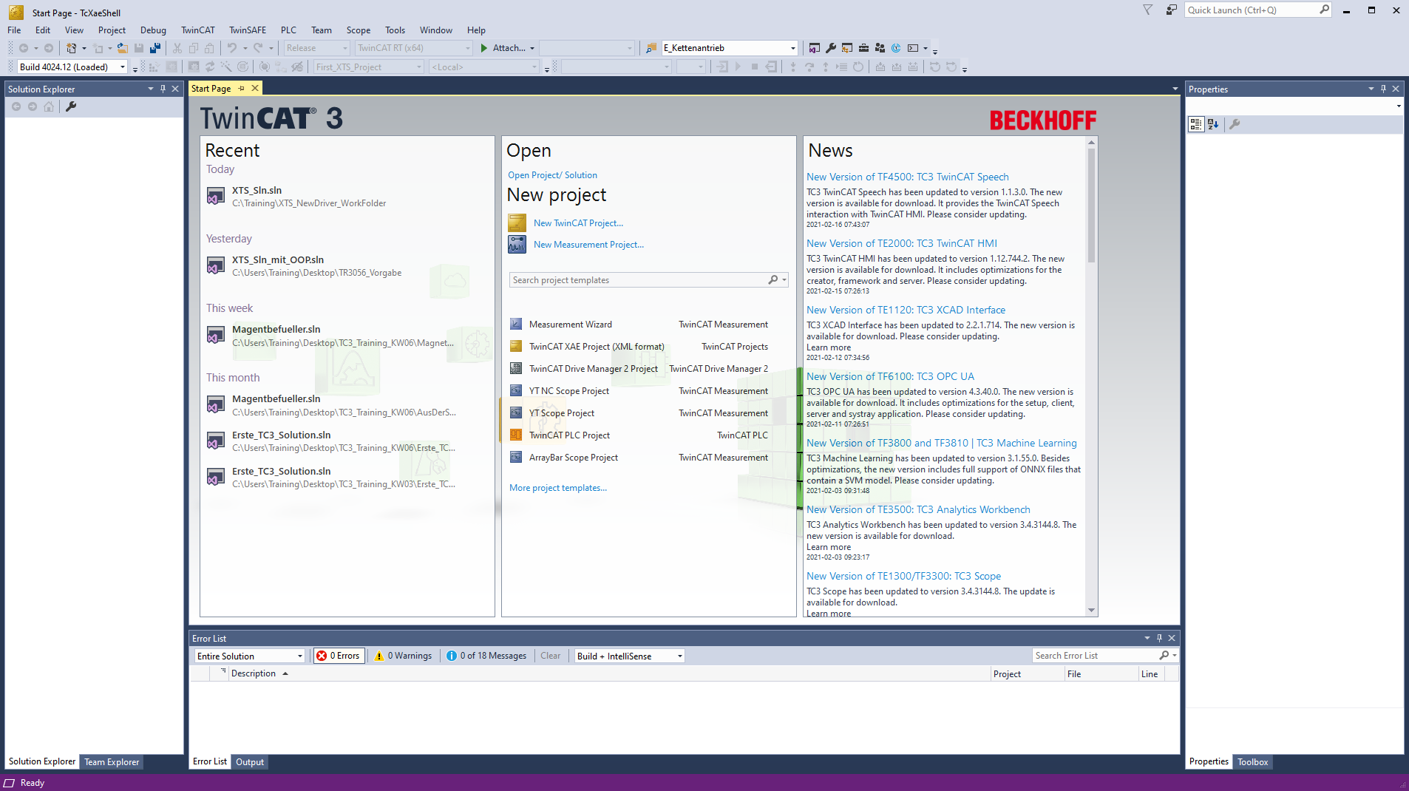
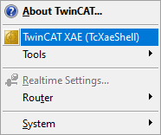


HardWare Scan | Opening a TC3 solution
TwinCAT 3 Engineering (XAE) is started via the TwinCAT icon.
2
1
TwinCAT 3 icon

Slide 17
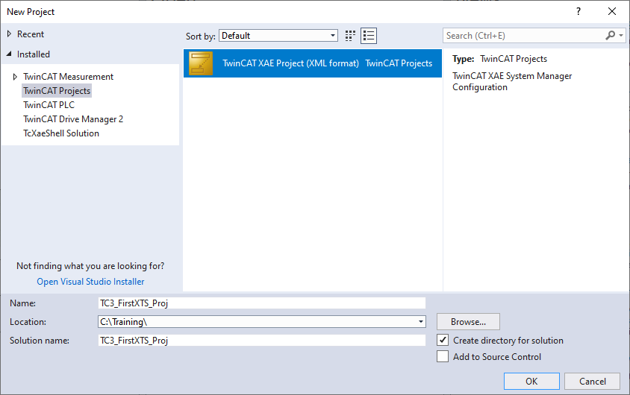
HardWare Scan | Creating a new project
Create a new project via the start page or the New Project icon.
Select a project name and storage location and confirm with OK.

Slide 18
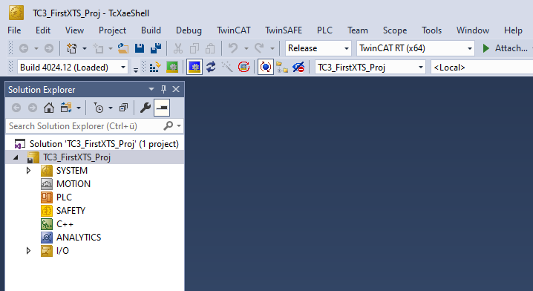
HardWare Scan | change to target system
When a new project is created,
the local target system “<Local>” is automatically selected.
Change to your XTS target system
The target system selection box shows the active target system.

Slide 19
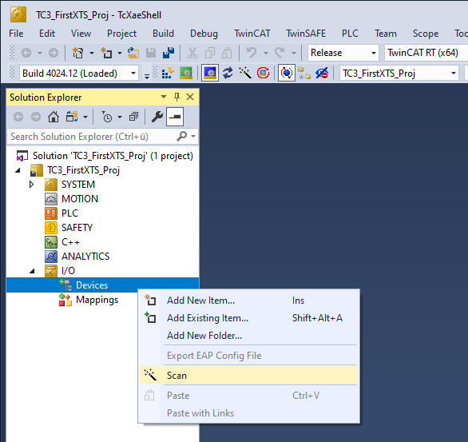

HardWare Scan | Scan HW-devices
The devices connected to the target system can be scanned. i.e. the fieldbus connections or the devicespecific modules such as the Novram in the IPC
In the Solution Explorer, right-click on “Devices” under I/O and select Scan
A device scan is only possible from a target system that is in Config mode.

Slide 20
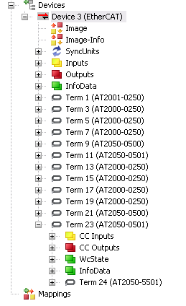
HardWare Scan | found HW-devices
Once the scan has been completed all the hardware should have been found
The first module is the straight section infeed module.
AT2001-0250
Each module includes
a motor module (AT200X-0250 or AT2050-0500)
and a sensor lines (AT200X-5250 or AT2050-5501

Slide 21
Agenda | XTS- Assembly
XTS-StarterKit
Preparation and Assembly
First Test
Rail mounting
Rerailing of Mover

Slide 22
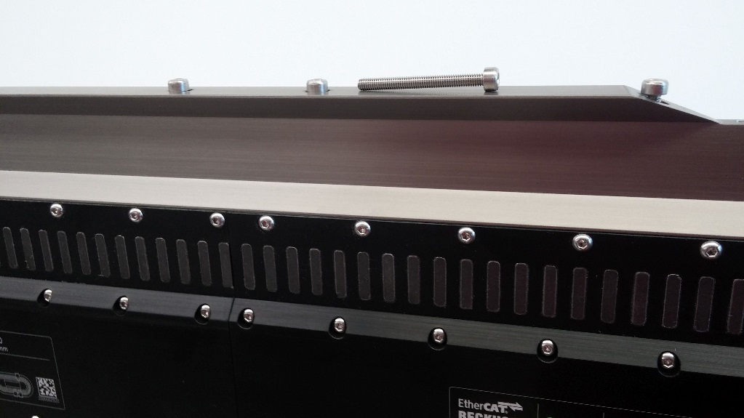
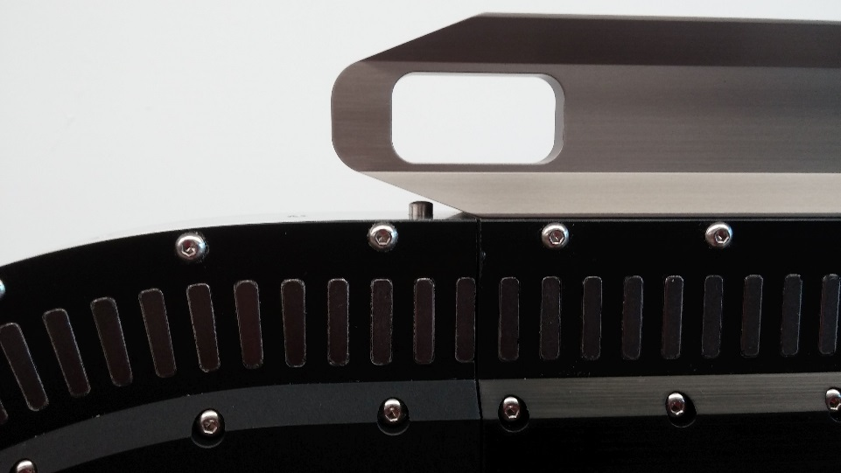
Rail module mounting
Screw the rail onto the system, beginning with the straight and finish with the two curves
Screw M4x40 Cyl. A2 DIN 912
!
Do not tighten the screws to allow for adjustment of the rail

Slide 23
Rail module mounting
Important: If the transition between straight and curve does not fit well it may push out the pin between straight and curve rail.
Important: If the pins between curve rail and curve motor module will not fit you may leave them out
Shorter pins Pin D5x8 A2 DIN 7
(lower HW28)
!
Do not tighten the screws to allow for adjustment of the rail

Slide 24
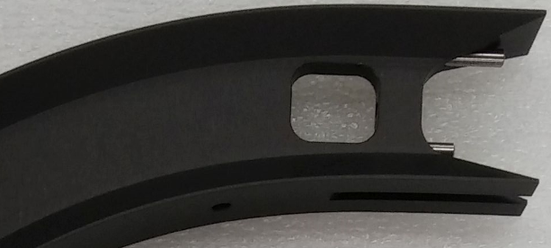
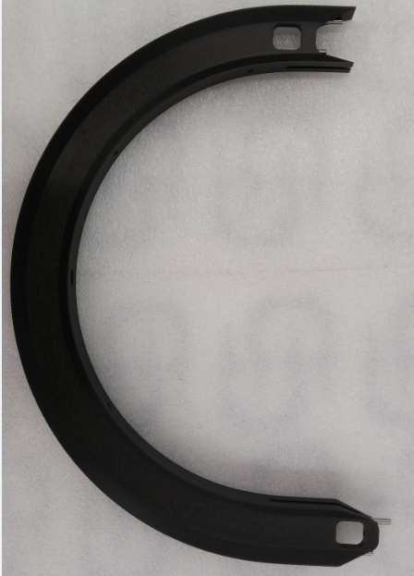
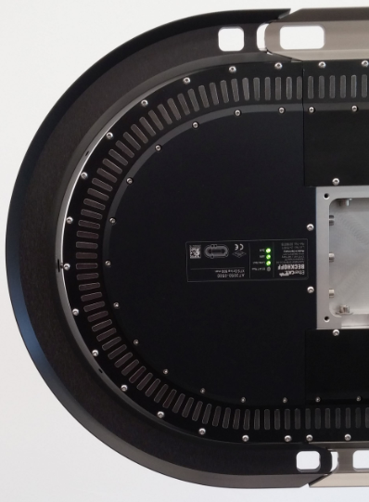
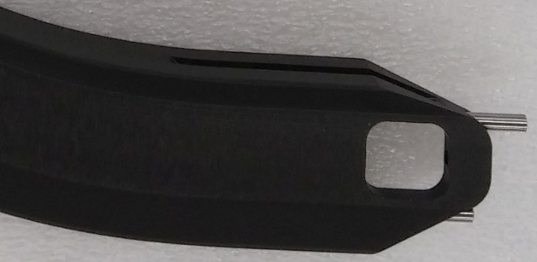
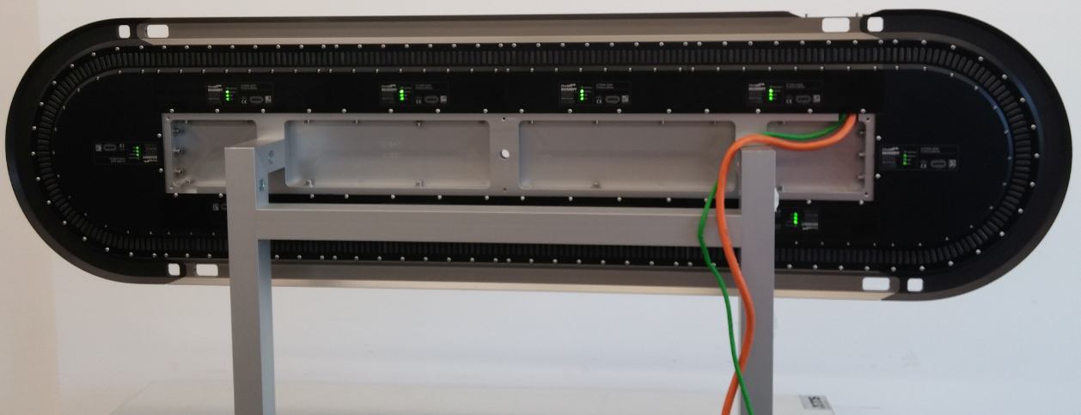
Rail module mounting
Construction after mounting the straight rails
Pin D4x16 A2 DIN 7

Slide 25
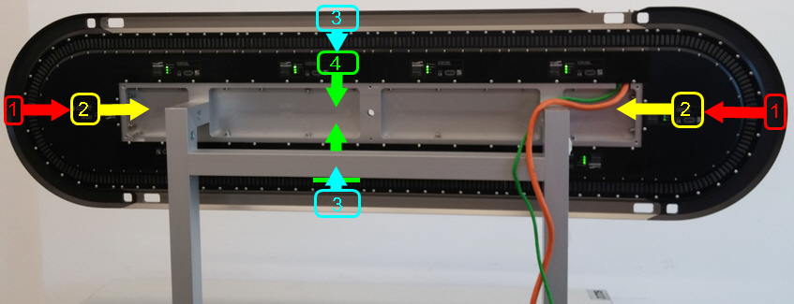
Rail module mounting
Now tighten the screws to the specified torque in this sequence:
1st - two curved rails with 2x 4 Screw M4x40 4Nm
2nd - two curved motor modules with 2x 3 Screw M5x30 6Nm
3rd - the straight rails with 22x Screw M4x40 4Nm
4th - the straight modules with 24x Screw M5x20 6Nm

Slide 26
Agenda | XTS- Assembly
XTS-StarterKit
Preparation and Assembly
First Test
Rail mounting
Rerailing of Mover

Slide 27
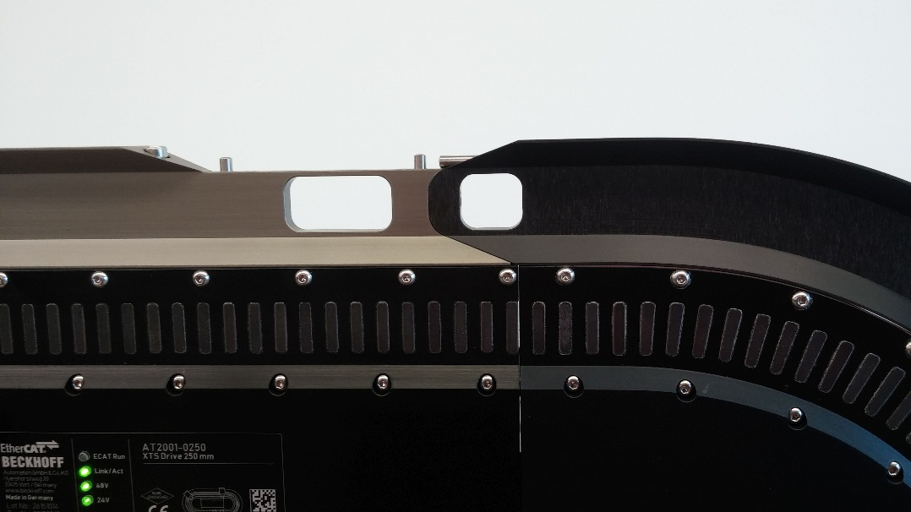
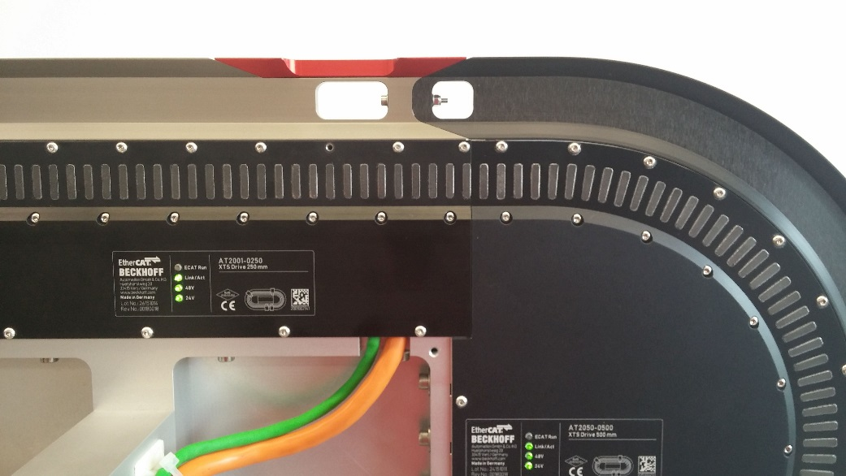
Mover and Rail
Construction after mounting the curved rails
Close the red auxiliary lock cover
Pin D4x12 A2 DIN 7
Screw M4x10 Cyl. A2 DIN 91
Important: Don’t forget the pins for the gate

Slide 28
Mover and Rail
Construction after mounting the curved rails
Connect curved and straight rail
Screw M3x30 A2 DIN 912
Washer M3x30 A2 DIN 125
Nut M3 A2 DIN 985
Important: Don't forget the screws for connecting

Slide 29
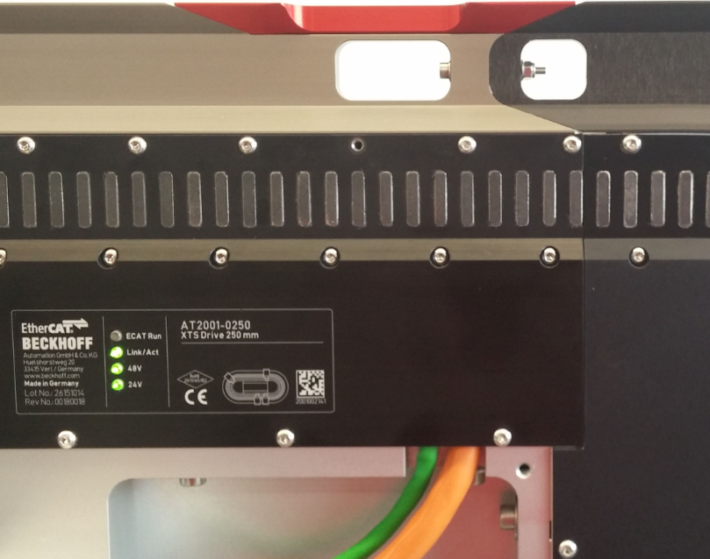
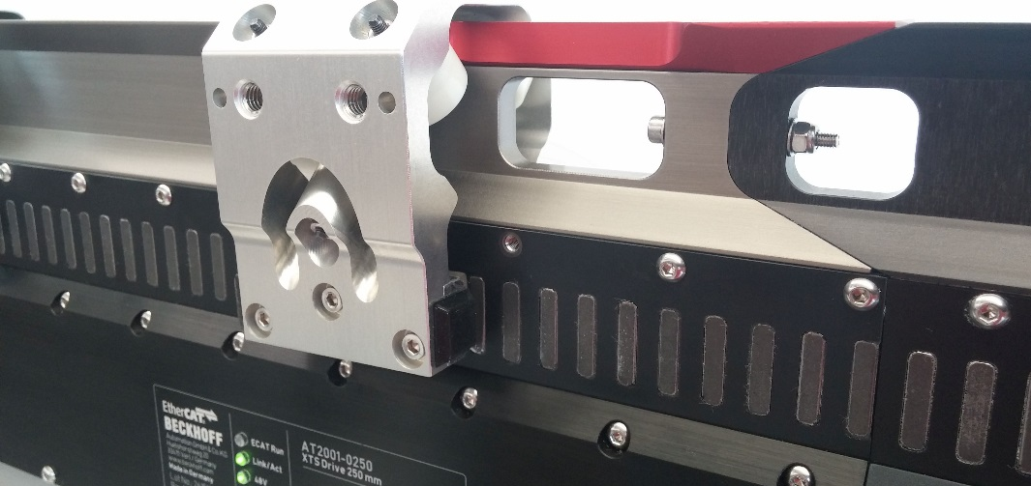
Mover and Rail
It may be necessary to remove on motor module screw for easy insertion of the mover (lower HW22)
Insert the Mover
Attention: The encoder flag should be on the same side as the XTS sensor (not the side of the name plate and LEDs)

Slide 30
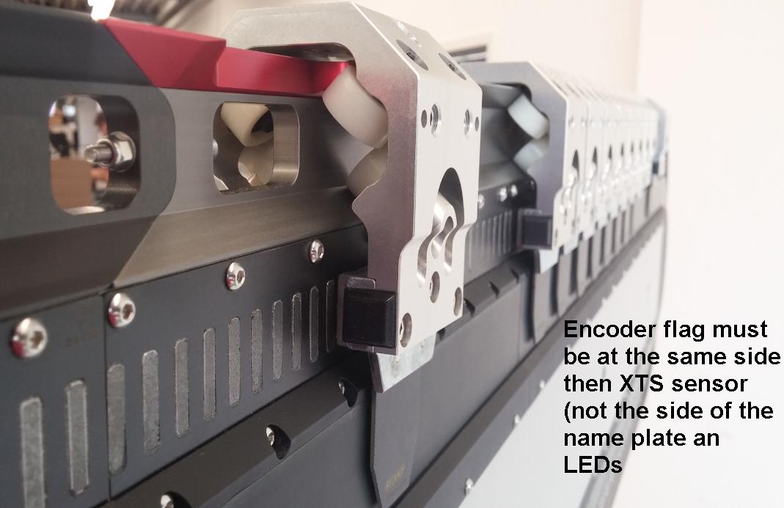
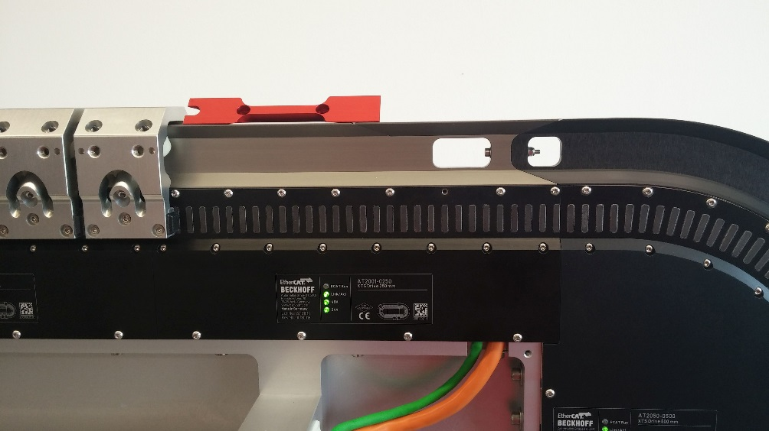
Mover and Rail
Remove the red auxiliary lock cover to replace the lock cover again,
Pin D4x12 A2 DIN 7
Screw M4x10 Cyl. A2 DIN 91
Important: Don’t forget the pins for the gate
Notes:
Note for photo text:
“Encoder flag must be on the same side as the XTS sensor (opposite the printed nameplate and LEDs).”

Slide 31
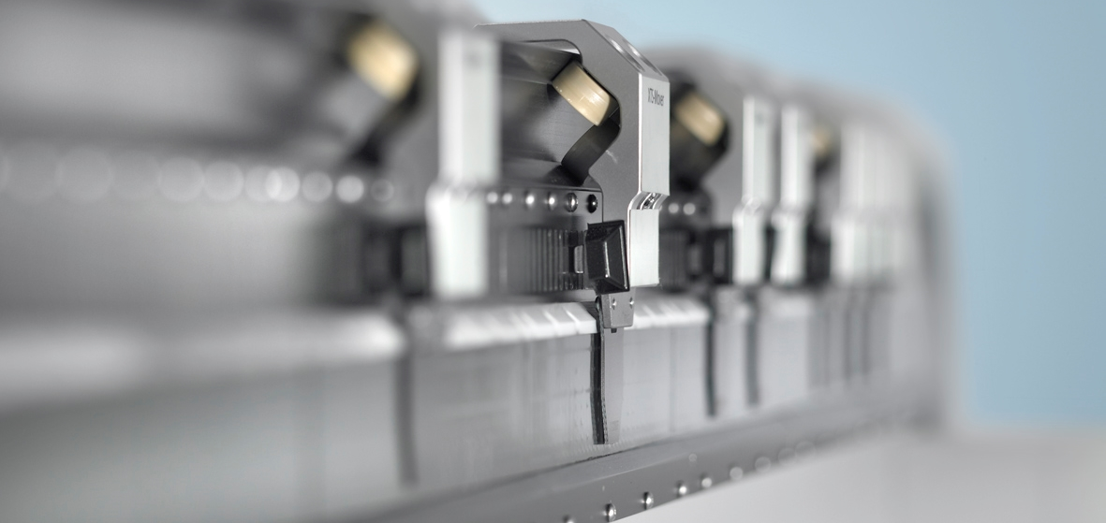
XTS | New Freedom in Machine Building
Complex sequences – simplified solution: XTS

Slide 32
Training material
This training material is provided to complement the presented training content. Outside the actual training the material may only be used for internal purposes at the company of the course participant. In addition, the material or extracts thereof may be used in end customer training for products containing Beckhoff products, or for presentations, provided the presentation refers to Beckhoff products. Extracts or copies of the training material must contain the following copyright acknowledgement: “© Beckhoff Automation GmbH & Co. KG”.
The same applies to extracts from presentation material. The user of the material is solely responsible for the completeness of extracts and copies. It is explicitly not permitted to offer commercial or free training for Beckhoff products. This applies to training with and or without the training material. The training material must not be edited, manipulated or modified.
Passing on of the aforementioned rights to third parties is not permitted.
Beckhoff Automation GmbH & Co. KG

Slide 33
02/2021

